Slide 1

Introduction to Machine Learning (BCSE-0105 )
Subject Teacher
Mr. Ankur Chaturvedi

Slide 2
Machine Learning: A Definition
A computer program is said to learn from experience E with respect to some class of tasks T and performance measure P, if its performance at tasks in T as measured by P, and improves with experience E.

Slide 3
What is Machine Learning?
(i) It is very hard to write programs that solve problems like recognizing a face.
We don’t know what program to write because we don’t know how our brain does it.
Even if we had a good idea about how to do it, the program might be horrendously complicated.
(ii) Instead of writing a program by hand, we collect lots of examples that specify the correct output for a given input.
(iii) A machine learning algorithm then takes these examples and produces a program that does the job.
The program produced by the learning algorithm may look very different from a typical hand-written program. It may contain millions of numbers.
If we do it right, the program works for new cases as well as the ones we trained it on.

Slide 4
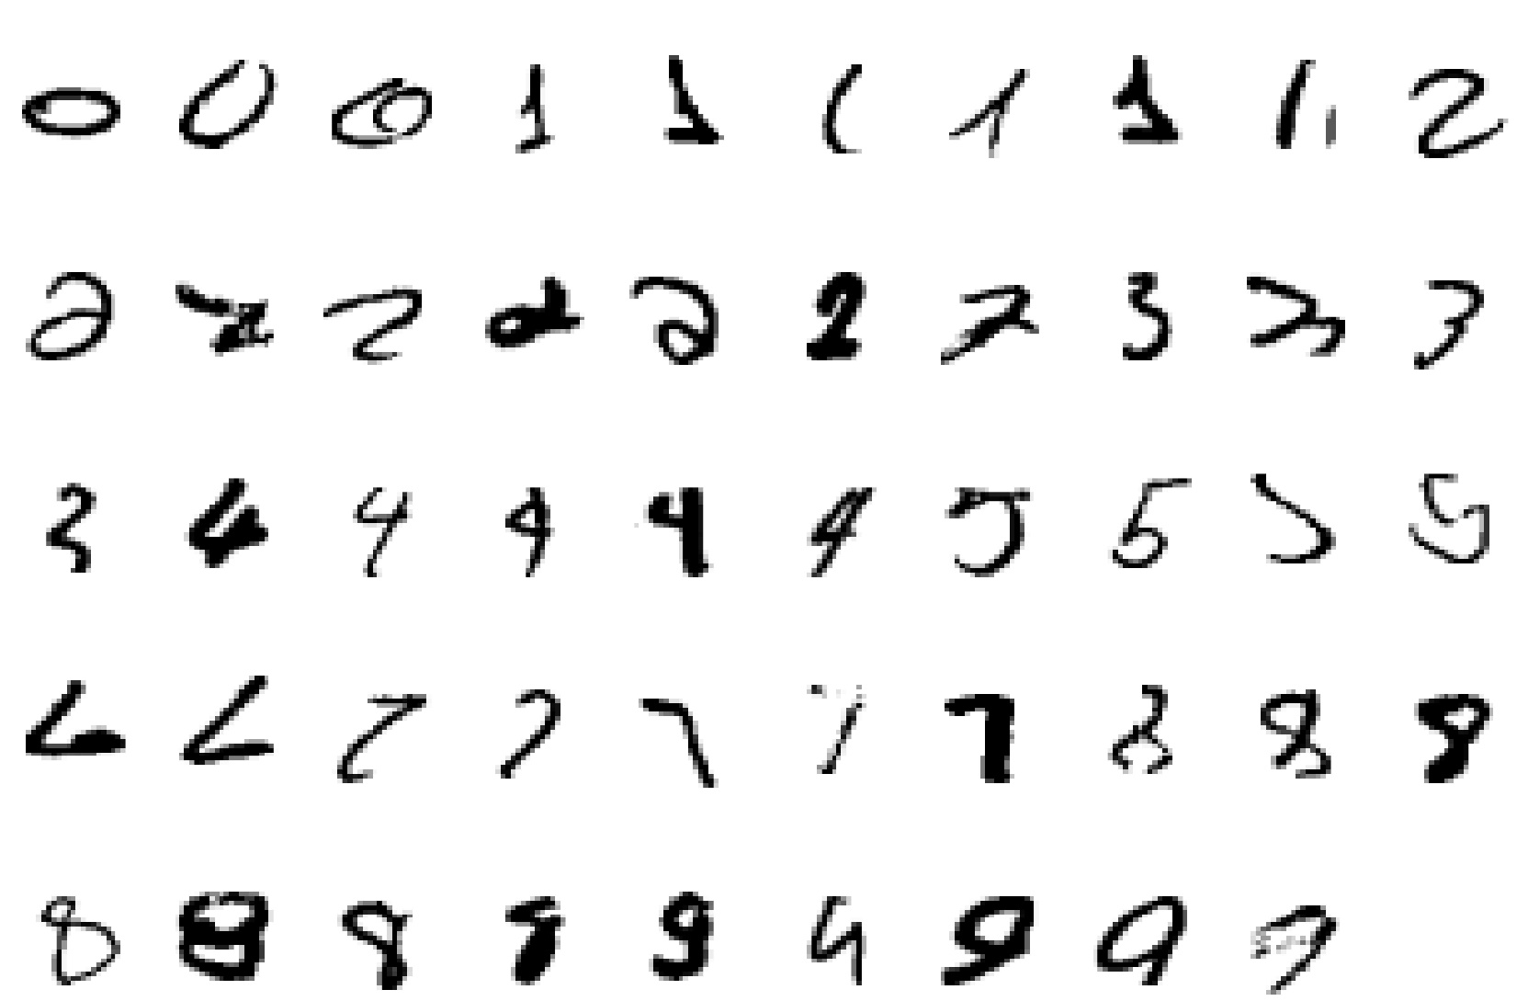
A classic example of a task that requires machine learning: It is very hard to say what makes a 2

Slide 5
Some more examples of tasks that are best solved by using a learning algorithm
Recognizing patterns:
Facial identities or facial expressions
Handwritten or spoken words
Medical images
Recognizing anomalies:
Unusual sequences of credit card transactions
Unusual patterns of sensor readings in a nuclear power plant or unusual sound in your car engine.

Slide 6
Some more examples….
Prediction:
Future stock prices or currency exchange rates
Some web-based examples of machine learning are….
The web contains a lot of data. Tasks with very big datasets often use machine learning
especially if the data is noisy or non-stationary.
Spam filtering, fraud detection:
The enemy adapts so we must adapt too.
Recommendation systems:
Lots of noisy data. Million dollar prize!
Information retrieval:
Find documents or images with similar content.

Slide 7
Importance of Machine Learning
Some tasks cannot be defined well, except by examples (e.g., recognizing people).
Relationships and correlations can be hidden within large amounts of data. Machine Learning/Data Mining may be able to find these relationships.
Human designers often produce machines that do not work as well as desired in the environments in which they are used.

Slide 8
Importance of Machine Learning
The amount of knowledge available about certain tasks might be too large for explicit encoding by humans (e.g., medical diagnostic).
5. Environments change over time.

Slide 9
Questions
Q1. Differentiate data mining and machine learning?
Q2. What do you mean by experience in machine learning?
Q3. Which type of problems can be solved using machine learning?
Q4. What is learnt in machine learning using experience?

Slide 10
Questions
Q5. What is not Machine Learning?
(i) Artificial Intelligence (ii) Rule based inference
To be explored by you
What is the difference between artificial learning and machine learning?

Slide 11
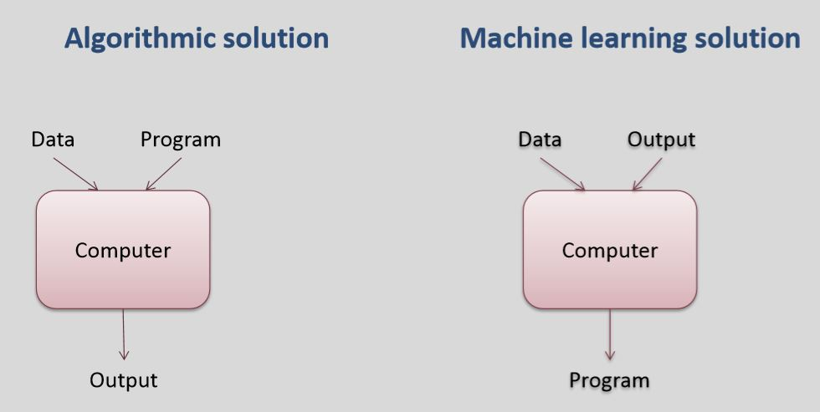
Program Vs. Machine Learning

Slide 12
When to use Machine Learning?
Human expertise does not exist
(navigating on Mars)
Humans are unable to explain their expertise
(speech recognition)
Solution changes in time
(routing on a computer network)
Solution needs to be adapted to particular cases
(user biometrics)

Slide 13
Components of a Learning System
Task (T)
Data (Experience, E)
Performance Measure (P)

Slide 14
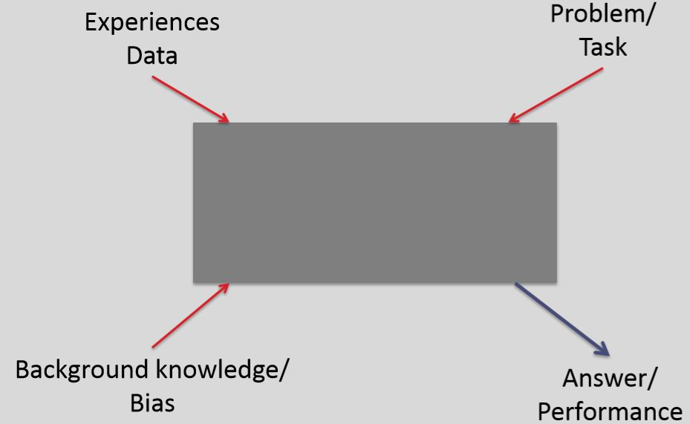
Learner System as Black Box

Slide 15
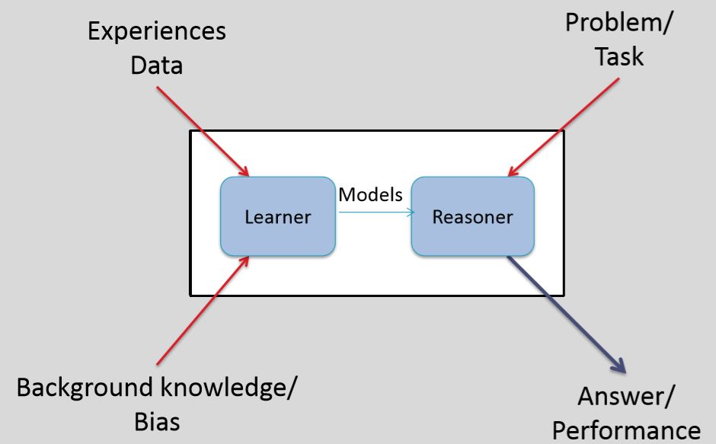
Learning System

Slide 16




Work of Learner
Example:
Bird VS Lion
Sports VS Entertainment
?

Slide 17
Learning Process
Computer attempts to learn a concept, i.e., a general description
Input = examples
An example is described by
Value for the set of features/ attributes and the concept represented by the example
Example: <temperature=high, humidity=high, Rain=Yes>
Output = representation of the concept
High temperature & low humidity => No Rain
With multiple such features, more accurate classification can take place

Slide 18
Learning Process contd…
Learning involves
Learning general models (target function) from data
Build a model that is a good and useful approximation to the data

Slide 19
Designing a Learning System
In designing a learning system, one has to deal with (at least) the following issues:
Choose training experience.
Choose target function.
Choose representation of target function.
Choose a learning algorithm.

Slide 20
Choosing Training Experience (Example: Playing Chess)
The key attributes of training experience.
Direct or Indirect examples
Controlled or uncontrolled sequence of training examples.
The test data is best described by testing data

Slide 21
Learning Algorithm
In order to learn the (approximated) target function we require:
A set of training examples (input arguments)
A rule for estimating the value corresponding to each training example (if this is not directly available)
An algorithm for choosing the function that best fits the training data

Slide 22
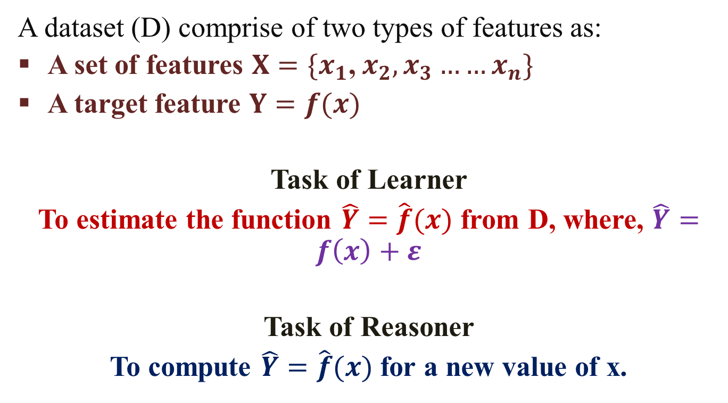
Mathematical Understanding
A dataset (D) comprise of two types of features as:
A set of features $X=\{x_{1}$, $x_{2},x_{3}……x_{n}\}$
A target feature $Y=f(x)$
Task of Learner
To estimate the function $\hat{Y}=\hat{f}(x)$ from D, where, $\hat{Y}=f\left(x\right)+ε$
Task of Reasoner
To compute $\hat{Y}=\hat{f}(x)$ for a new value of x.

Slide 23
Mathematical Understanding
A dataset (D) comprise of two types of features as:
A set of features $X=\{x_{1}$, $x_{2},x_{3}……x_{n}\}$
A target feature $Y=f(x)$
Task of Learner
To estimate the function $\hat{Y}=\hat{f}(x)$ from D, where, $\hat{Y}=f\left(x\right)+ε$
Task of Reasoner
To compute $\hat{Y}=\hat{f}(x)$ for a new value of x.

Slide 24
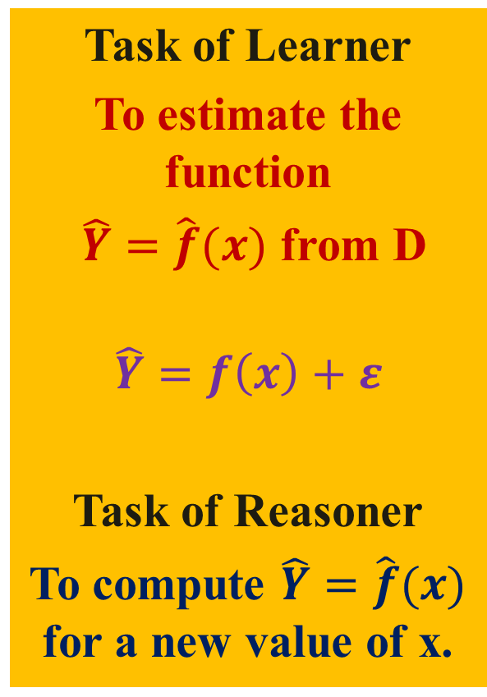
Mathematical Understanding
Task of Learner
To estimate the function
$\hat{Y}=\hat{f}(x)$ from D
$$\hat{Y}=f\left(x\right)+ε$$
Task of Reasoner
To compute $\hat{Y}=\hat{f}(x)$ for a new value of x.
Types of features (X and Y)
Categorical (such as blood group)
Ordinal (such as large, medium, or small)
Integer valued (such as no. of students)
Real valued (such as height, weight)
Categories of features (X and Y)
Discrete
Continuous
Height (x1) | Age (x2) | Complexion (x3) | Weight (x4)
5.1 | 20 | Fair | 60.5
2.1 | 3 | Dark | 20.2
6.7 | 30 | Dark | 80.6
4 | 10 | Fair | 40.5

Slide 25
Types of Machine Learning
Supervised Learning
Classification (When Y is discrete)
Regression (When Y is continuous)
Classification
Regression
Training Data
Training Data
Height (x1) | Age (x2) | Complexion (y)
5.1 | 20 | Fair
2.1 | 3 | Dark
6.7 | 30 | Dark
4 | 10 | Fair
Height (x1) | Age (x2) | Weight (y)
5.1 | 20 | 60.5
2.1 | 3 | 20.2
6.7 | 30 | 80.6
4 | 10 | 40.5
Predict the value of Complexion for Height=2.5 and Age=5.
Predict the value of weight for Height=2.5 and Age=5.

Slide 26
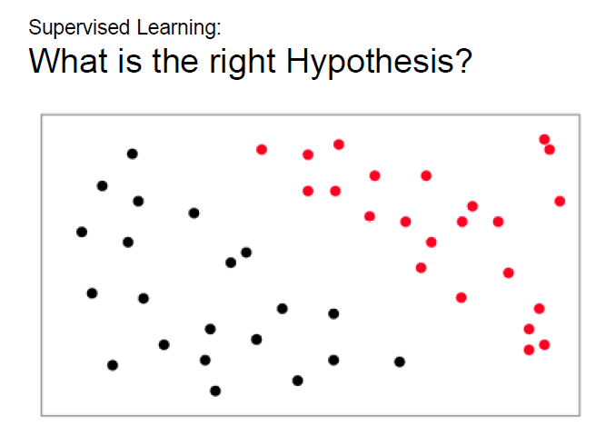
Types of Machine Learning

Slide 27
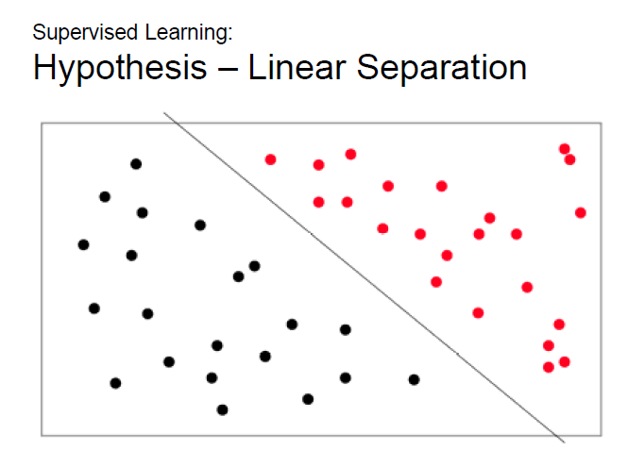
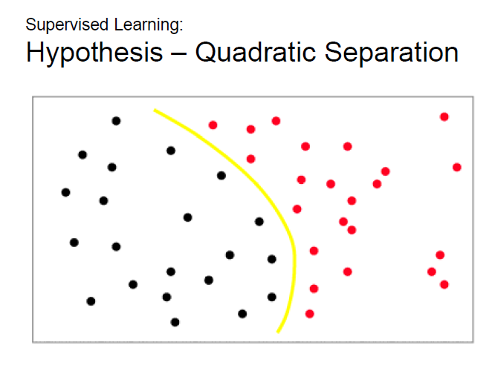
Types of Machine Learning

Slide 28
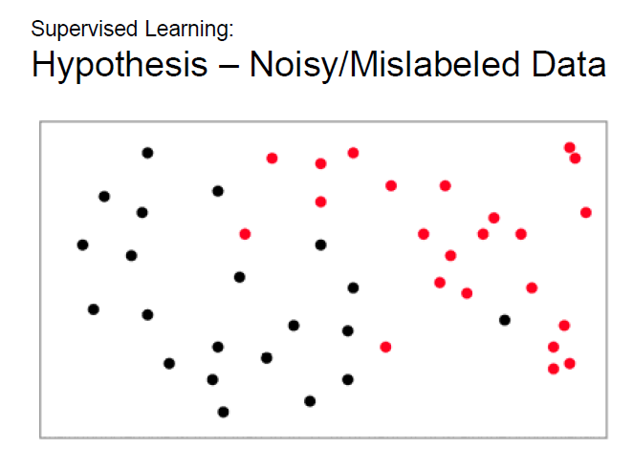
Types of Machine Learning

Slide 29
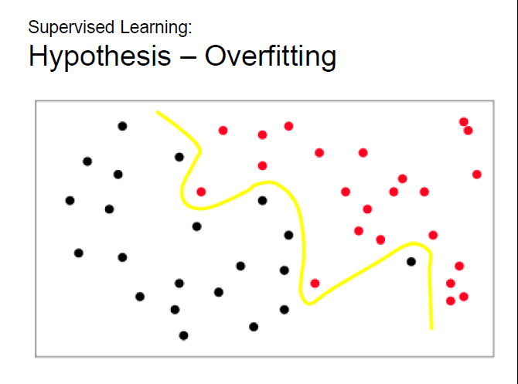
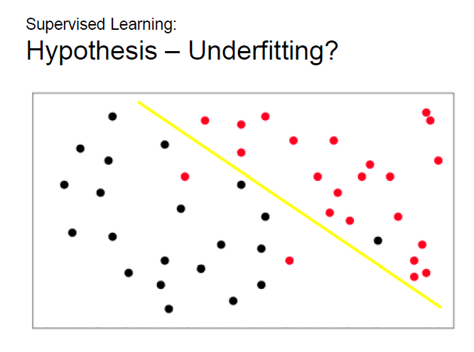
Types of Machine Learning

Slide 30
Types of Machine Learning
2. Unsupervised Learning
It draws inferences from the values of X to obtain pattern of the data.
Clustering
Type of Medicine | Weight | PH-Value
A | 1 | 1
B | 2 | 1
C | 4 | 3
D | 5 | 4
What is the type of a medicine with weight=2 and PH-value=2?

Slide 31
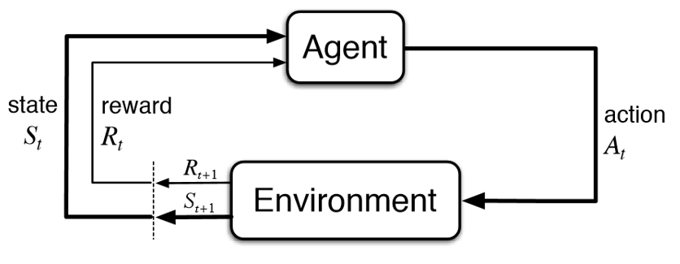
Types of Machine Learning
3. Reinforcement Learning
It enables an agent to learn in an interactive environment by trial and error using feedback from its own actions and experiences.
It uses rewards and punishments as signals for positive and negative behavior. (The supervised learning consists positive signal only)

Slide 32
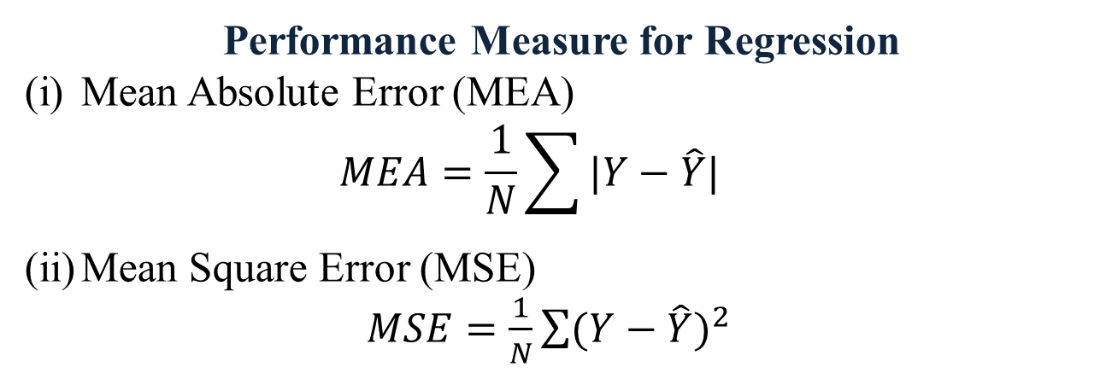
Performance Measures
(i) Supervised Learning
Regression – Squared Error or absolute error Classification - Precision/Recall
(ii) Unsupervised Learning
Clustering – Scatter
(iii) Reinforcement Learning – Award/Punishment
Performance Measure for Regression
Mean Absolute Error (MEA)
$$MEA=\frac{1}{N}\sum{|Y−\hat{Y}|}$$
Mean Square Error (MSE)
$MSE=\frac{1}{N}\sum{{(Y−\hat{Y})}^{2}}$

Slide 33
Performance Measures
Performance Measure for Classification
Confusion Matrix
 | Predicted
Actual | Class | Cat | Dog
 | Cat | 1 | 3
 | Dog | 0 | 8
True-Positive
False-Negative
True-Negative
False-Positive

Slide 34
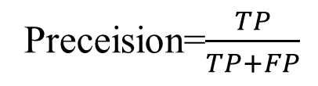
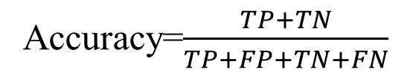
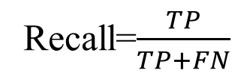
Performance Measures
(TP)/(TP+FP)
(TP)/(TP+FP)
Performance Measure for Classification
Confusion Matrix
 | Predicted
Actual | Class | Cat | Dog
 | Cat | 0 | 3
 | Dog | 1 | 4
Preceision=$\frac{TP}{TP+FP}$
Recall=$\frac{TP}{TP+FN}$
Accuracy=$\frac{TP+TN}{TP+FP+TN+FN}$

Slide 35
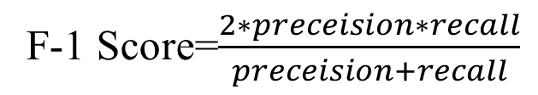
Performance Measures
(TP)/(TP+FP)
(TP)/(TP+FP)
Performance Measure for Classification
Confusion Matrix
F-1 Score=$\frac{2∗preceision∗recall}{preceision+recall}$
You Explore
The AUC curve to measure performance of classification.

Slide 36
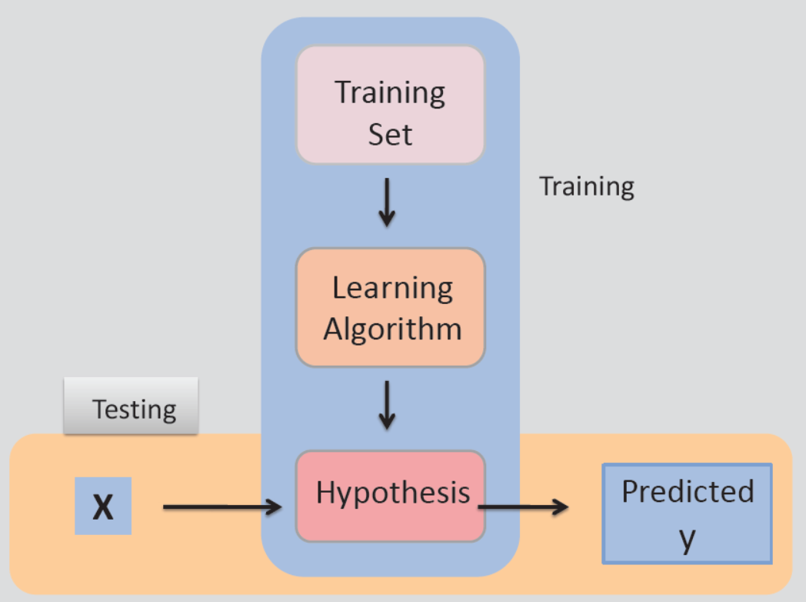
Process of Learning

Slide 37
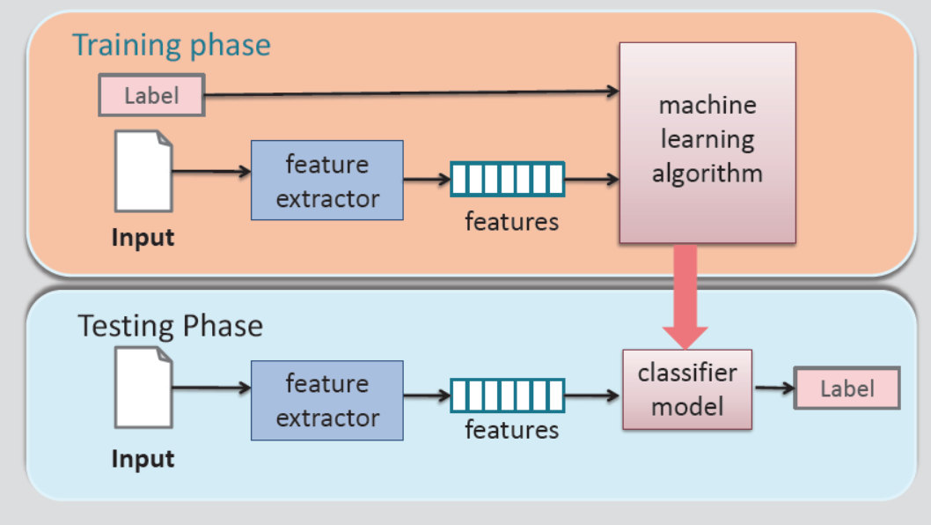
Process of Learning

Slide 38
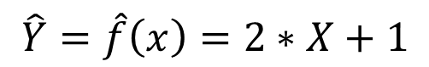
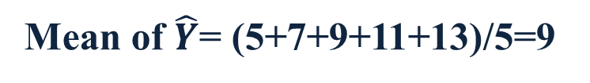
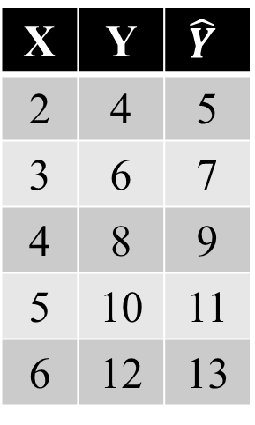
Bias and Variance
Consider the following training dataset.
X | Y
2 | 4
3 | 6
4 | 8
5 | 10
6 | 12
After applying linear regression algorithm over the training data, the following target function is estimated.
$$\hat{Y}=\hat{f}\left(x\right)=2∗X+1$$
X | Y | $$\hat{Y}$$
2 | 4 | 5
3 | 6 | 7
4 | 8 | 9
5 | 10 | 11
6 | 12 | 13
Mean of $\hat{Y}$= (5+7+9+11+13)/5=9

Slide 39
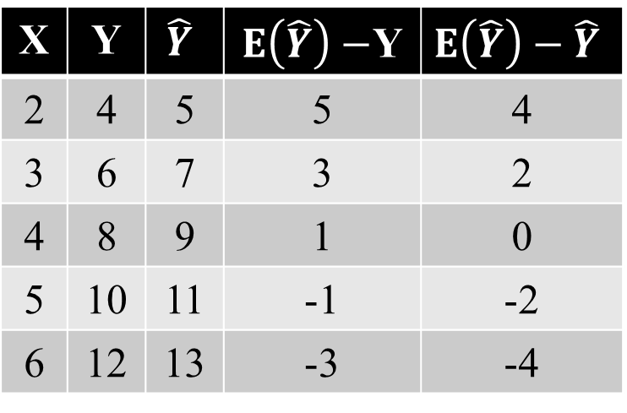
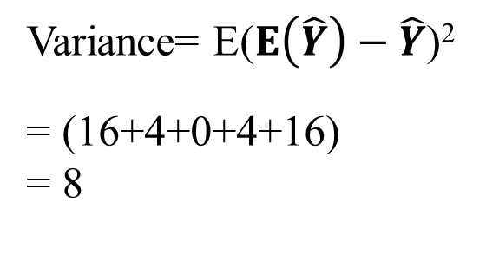
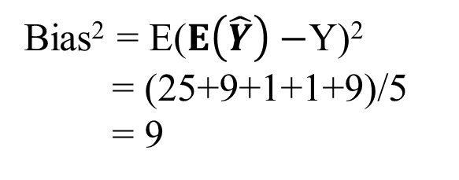
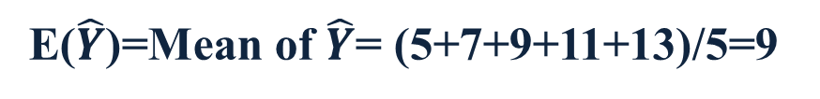
Bias and Variance
E($\hat{Y}$)=Mean of $\hat{Y}$= (5+7+9+11+13)/5=9
X | Y | $$\hat{Y}$$ | $E\left(\hat{Y}\right)−$Y | $$E\left(\hat{Y}\right)−\hat{Y}$$
2 | 4 | 5 | 5 | 4
3 | 6 | 7 | 3 | 2
4 | 8 | 9 | 1 | 0
5 | 10 | 11 | -1 | -2
6 | 12 | 13 | -3 | -4
Bias² = E($E\left(\hat{Y}\right)−$Y)²
= (25+9+1+1+9)/5
= 9
Variance= E($E\left(\hat{Y}\right)−\hat{Y}$)²
= (16+4+0+4+16)
= 8

Slide 40
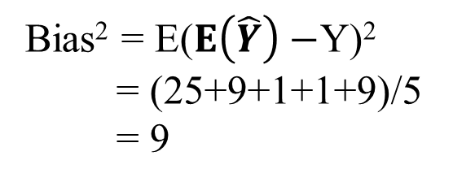
Bias and Variance
Bias² = E($E\left(\hat{Y}\right)−$Y)²
= (25+9+1+1+9)/5
= 9
Bias:
Bias is the difference between the average prediction of our model and the correct value which we are trying to predict.
Model with high bias pays very little attention to the training data and oversimplifies the model.
It always leads to high error on training and test data.

Slide 41
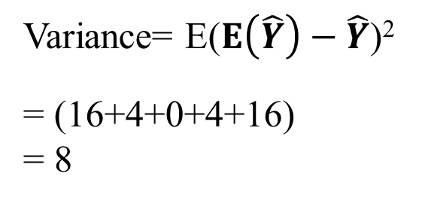
Bias and Variance
Variance= E($E\left(\hat{Y}\right)−\hat{Y}$)²
= (16+4+0+4+16)
= 8
Variance
Variance is the variability of model prediction for a given data point or a value which tells us spread of our data.
Model with high variance pays a lot of attention to training data and does not generalize on the data which it hasn’t seen before.
As a result, such models perform very well on training data but has high error rates on test data.

Slide 42
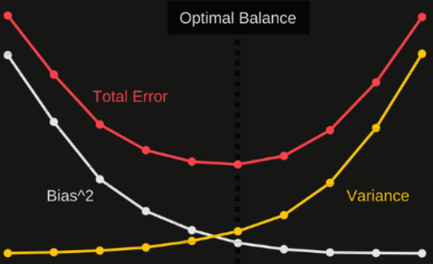
Bias and Variance Tradeoff
Error
Model Complexity

Slide 43
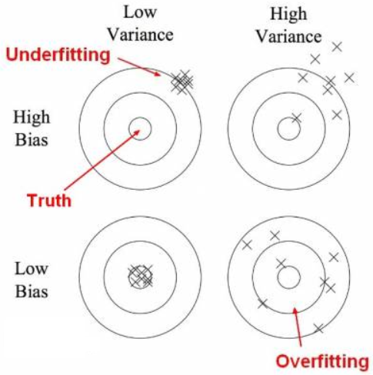
Bias and Variance Tradeoff

Slide 44
Linear Regression
Linear Regression is a linear approach to modeling the relationship between a scalar response and one or more explanatory variables.
The case of one explanatory variable is called simple linear regression. For more than one explanatory variable, the process is called multiple linear regression.

Slide 45
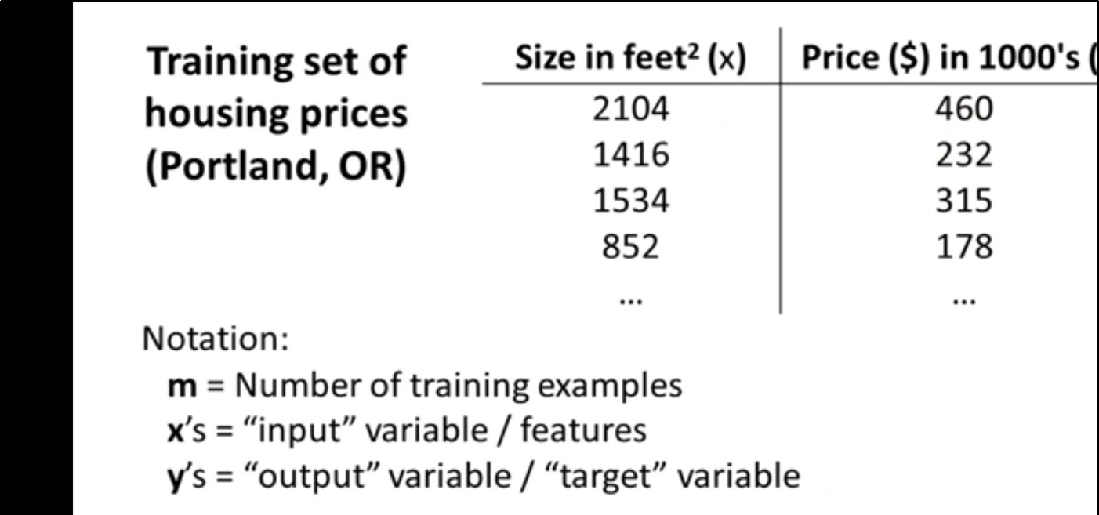
Example

Slide 46
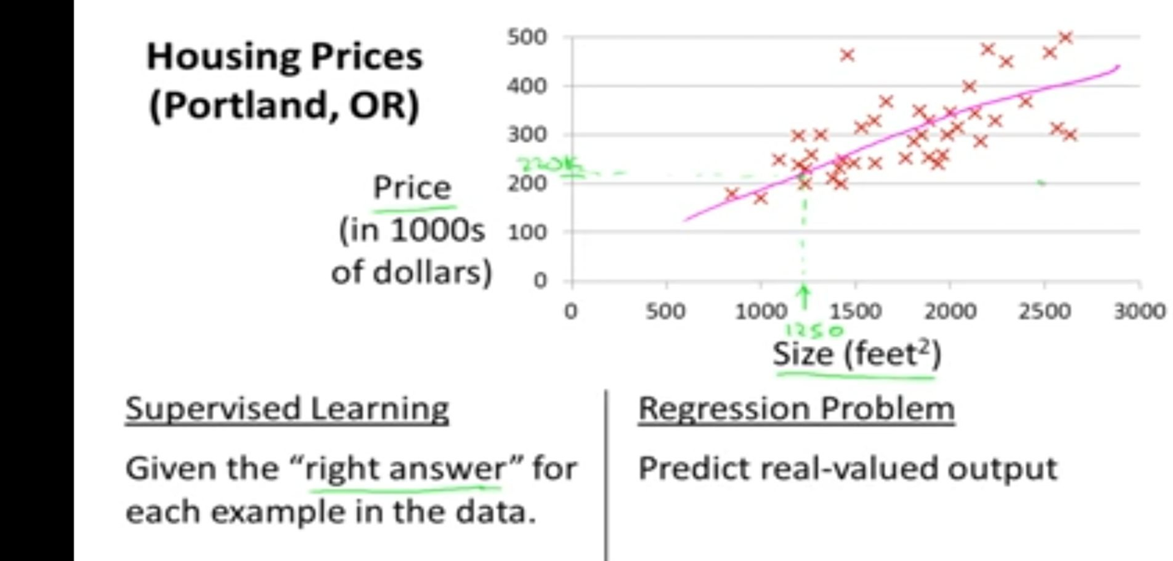
Example

Slide 47
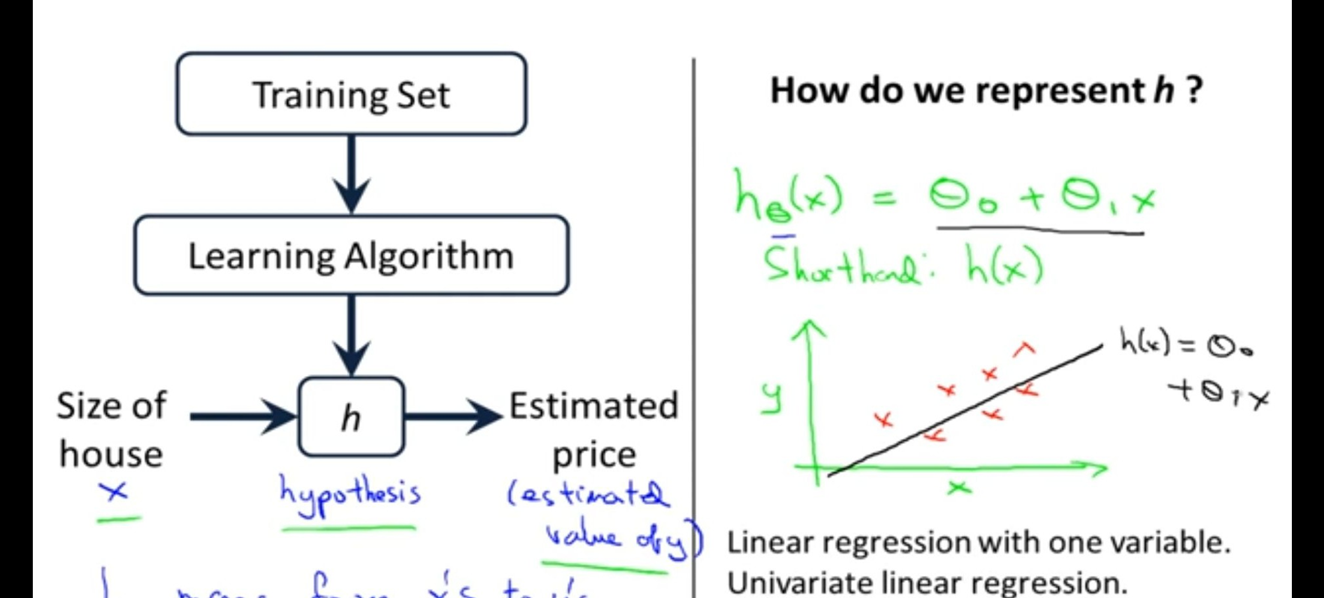
How to represent Linear Regression Model

Slide 48
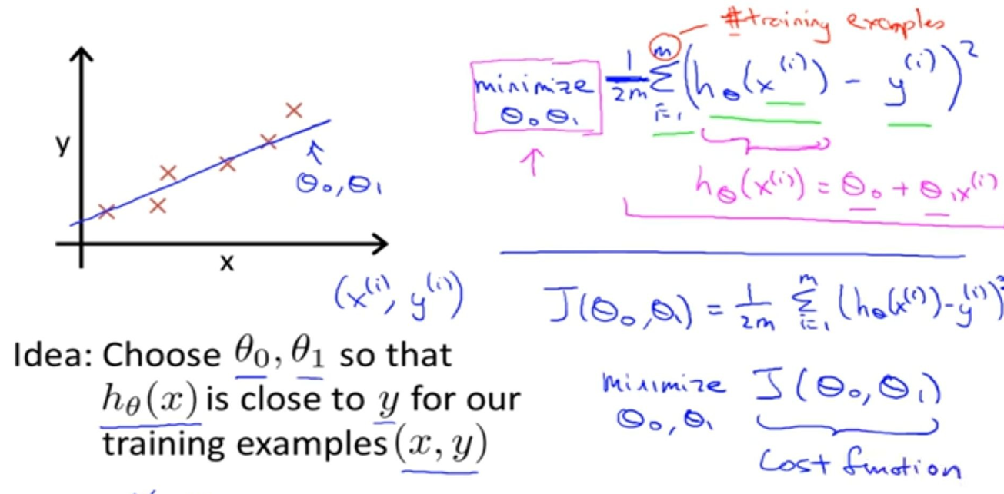
Cost Function in Linear Regression Model

Slide 49
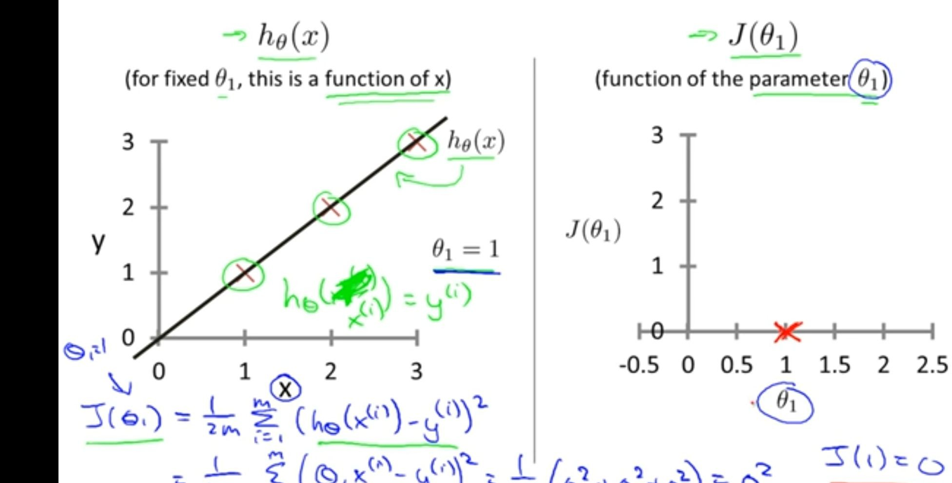
Regression line vs Cost function

Slide 50
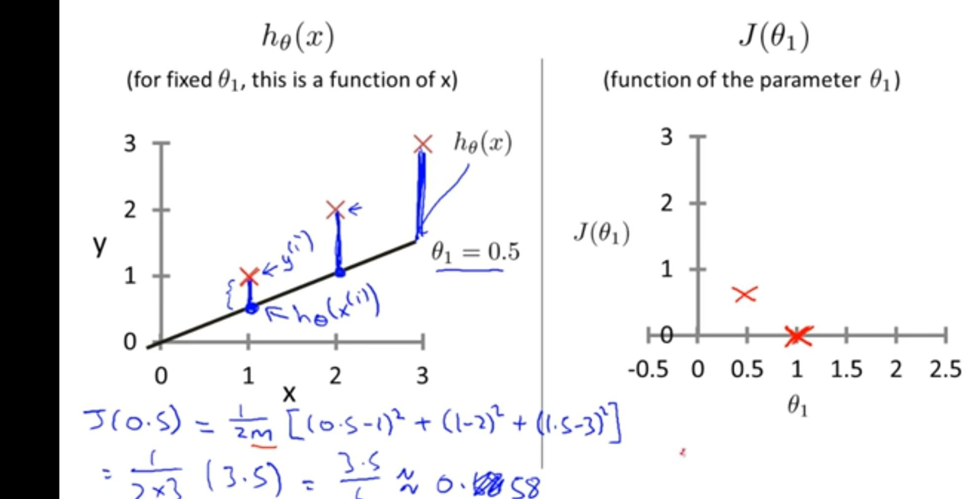
Regression line vs Cost function

Slide 51
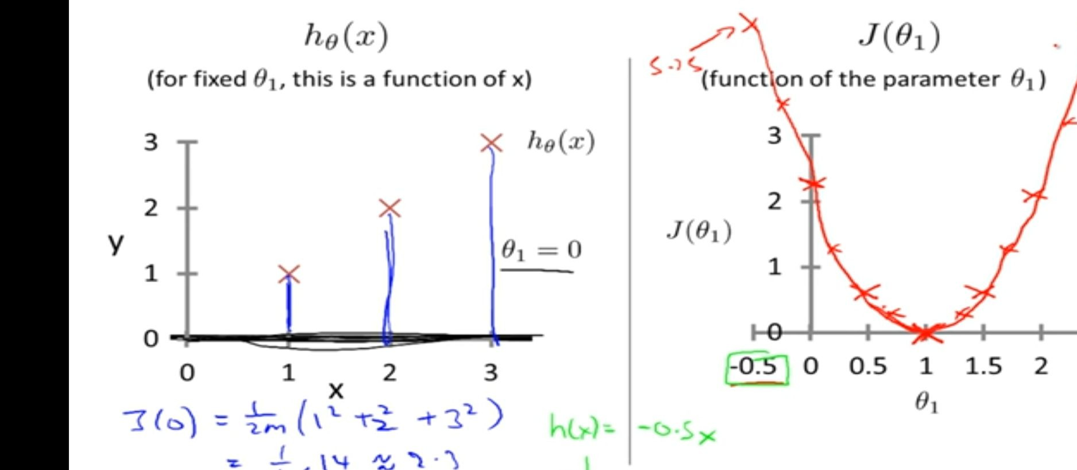
Regression line vs Cost function

Slide 52

Introduction to Machine Learning (BCSE-0701 ) Day-13
Topic
Multiple Linear Regression

Slide 53
Introduction to Machine Learning (BCSE-0701 ) Day-14
Topic
Gradient Descendent

Slide 54
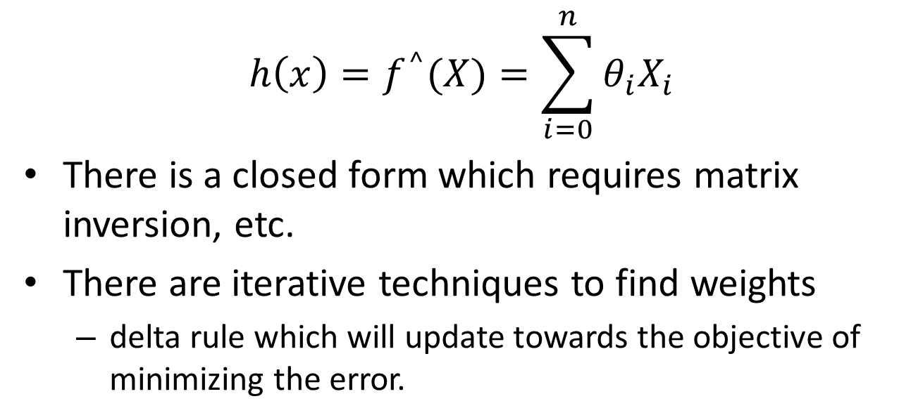
Multiple Linear Regression
$$Y=θ_{0}+θ_{1}X_{1}+θ_{2}X_{2}+…+θ_{n}X_{n}$$
$$h\left(x\right)=f^{^}(X)=\sum_{i=0}^{n}{θ_{i}X_{i}}$$
There is a closed form which requires matrix inversion, etc.
There are iterative techniques to find weights
delta rule which will update towards the objective of minimizing the error.
Notes:
Note target really is the point being regressed to each time. Now makes better sense since net is the output and we want to minimize error of the target.

Slide 55
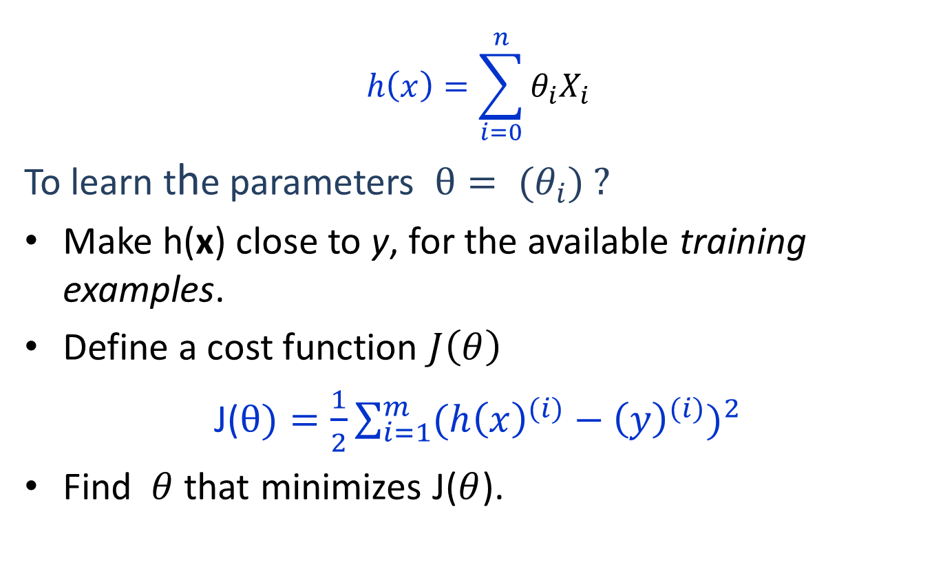
Linear Regression
$$h\left(x\right)=\sum_{i=0}^{n}{θ_{i}X_{i}}$$
To learn the parameters $θ= (θ_{i}) ?$
Make h(x) close to y, for the available training examples.
Define a cost function $J\left(θ\right)$
J($θ)=\frac{1}{2}\sum_{i=1}^{m}{{(h{\left(x\right)}^{(i)}−{\left(y\right)}^{(i)})}^{2}}$
Find $θ$ that minimizes J($θ$).

Slide 56
Gradient Descent
Gradient descent is an optimization algorithm used to minimize some function by iteratively moving in the direction of steepest descent as defined by the negative of the gradient.
In machine learning, we use gradient descent to update the parameters of our model. Parameters refer to coefficients in Linear Regression and weights in neural networks.

Slide 57
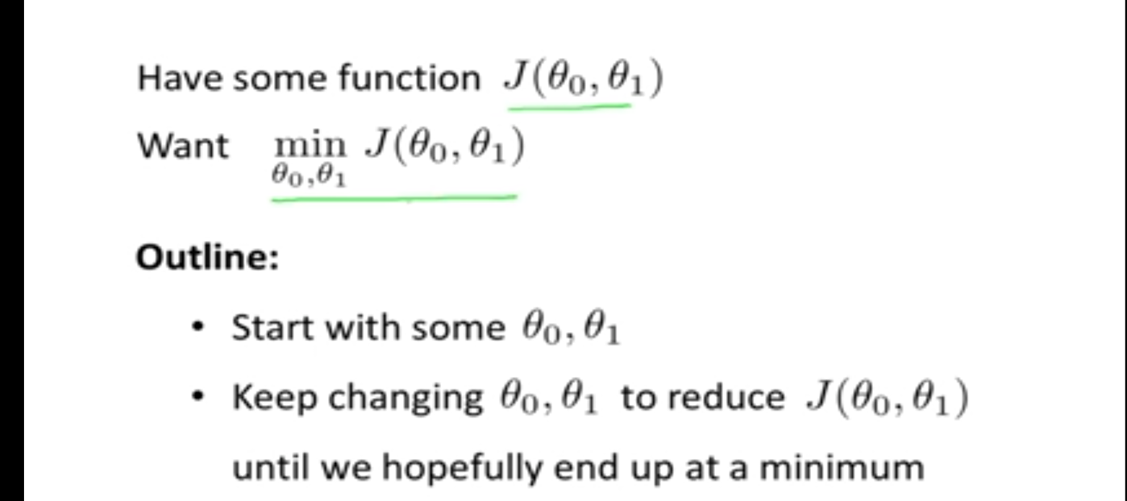
Idea of Gradient Descent

Slide 58
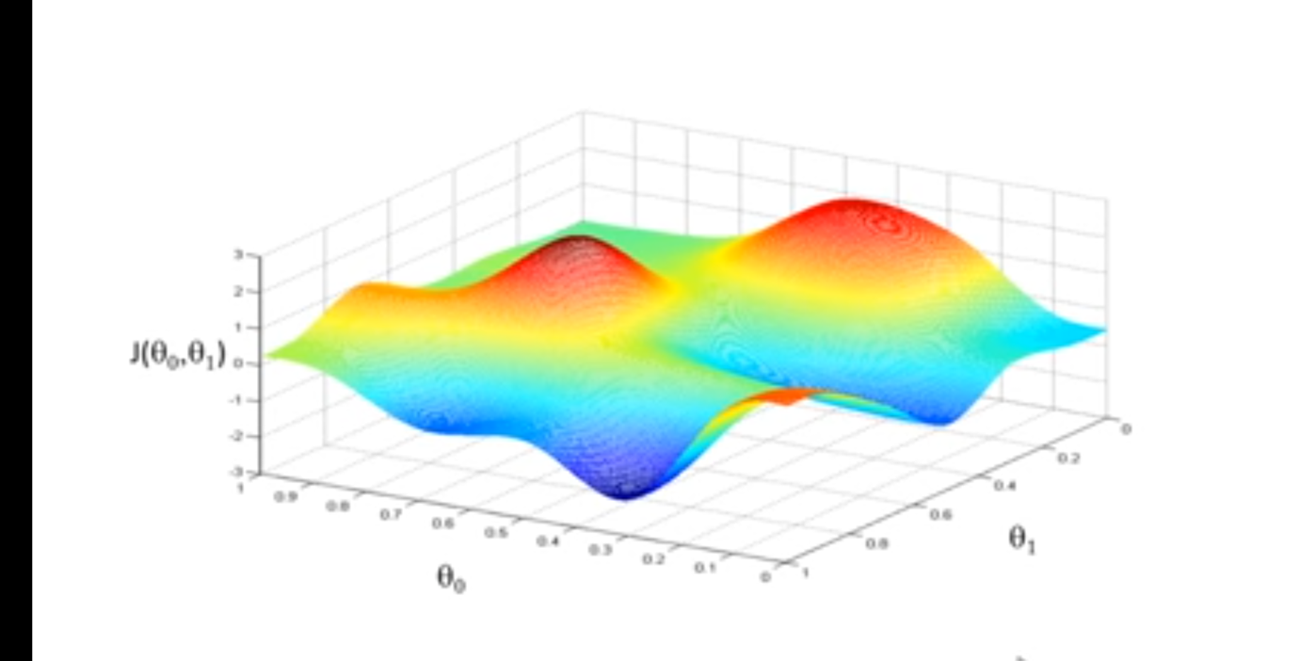
Idea of Gradient Descent

Slide 59
Introduction to Machine Learning (BCSE-0701 ) Day-15
Topic
Gradient Descendent contd…

Slide 60
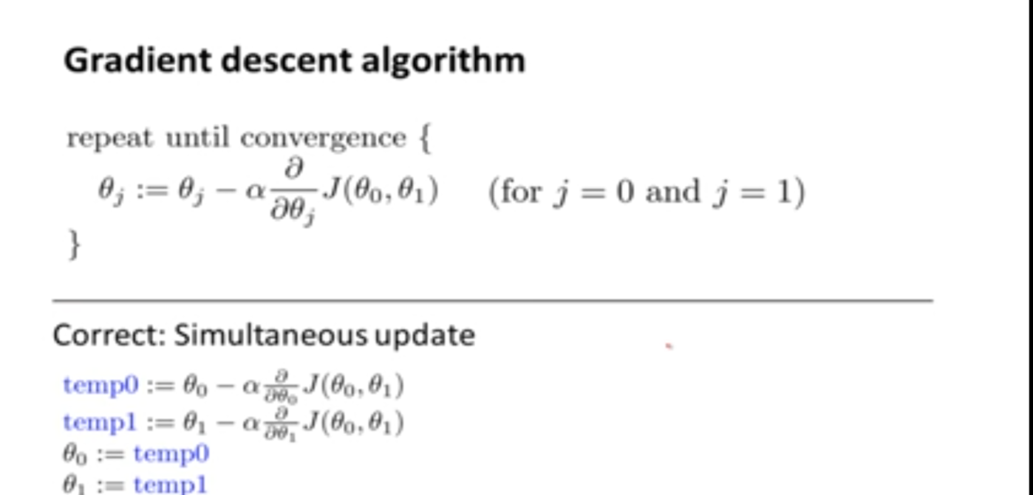
Gradient Descent Algorithm

Slide 61
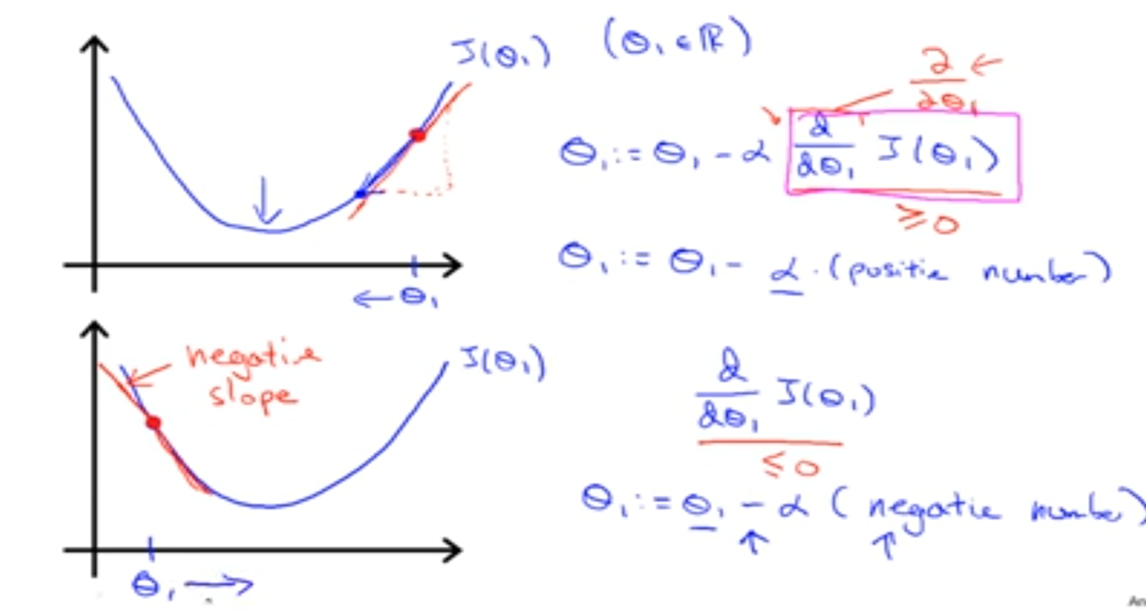
Analysis

Slide 62
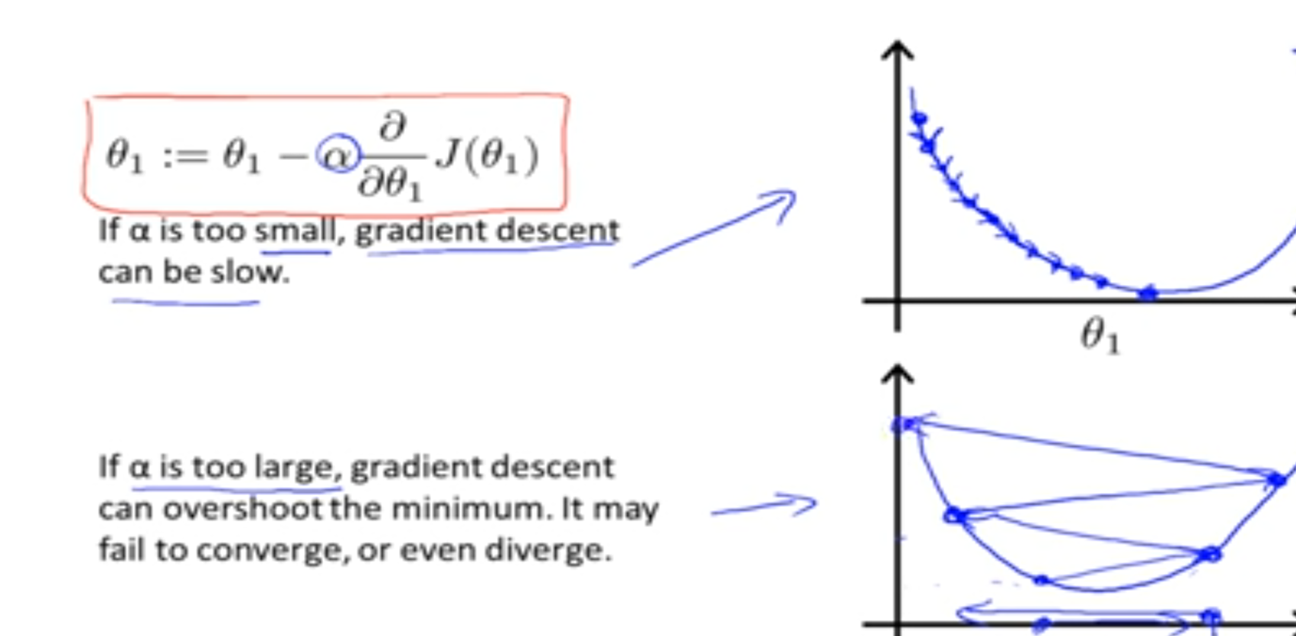
Analysis

Slide 63
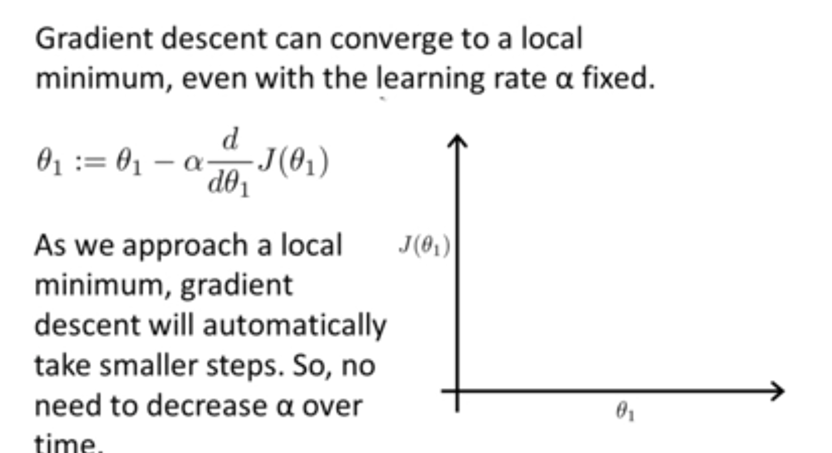
Analysis

Slide 64
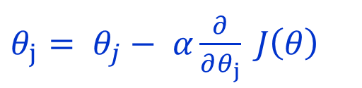
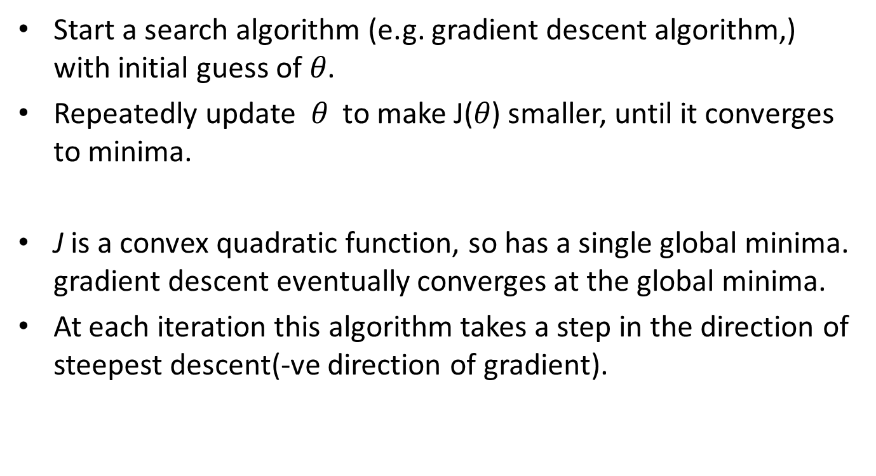
Gradient Descendent Algorithm
Start a search algorithm (e.g. gradient descent algorithm,) with initial guess of $θ$.
Repeatedly update $θ$ to make J($θ$) smaller, until it converges to minima.
J is a convex quadratic function, so has a single global minima. gradient descent eventually converges at the global minima.
At each iteration this algorithm takes a step in the direction of steepest descent(-ve direction of gradient).
$θ_{j}= θ_{j}− α\frac{∂}{∂θ_{j}} J\left(θ\right)$

Slide 65
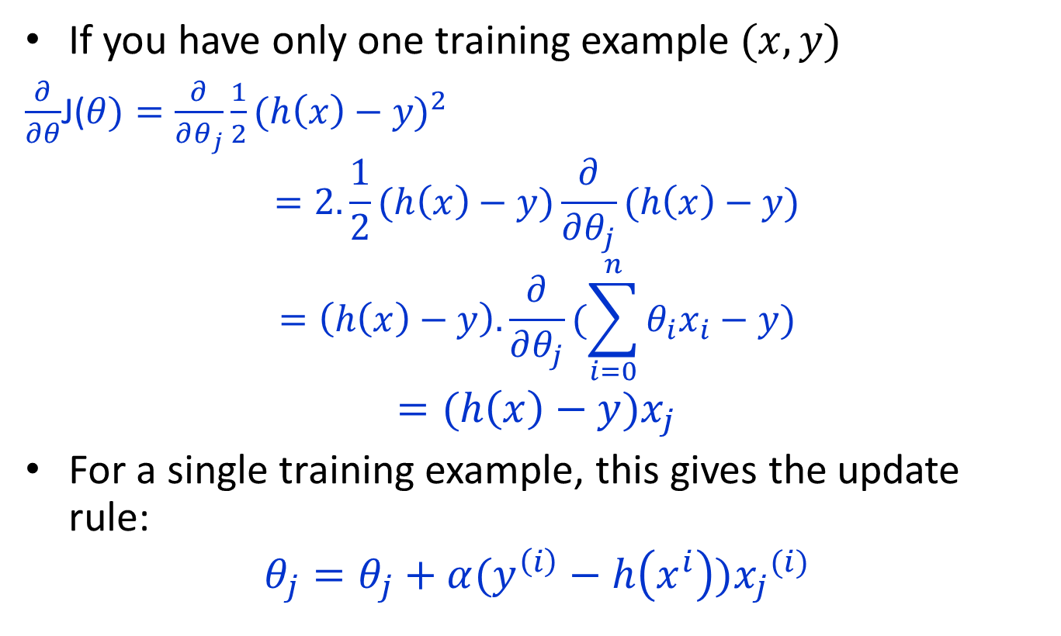
Gradient Descendent Update Rule
If you have only one training example $(x,y)$
$\frac{∂}{∂θ}$J($θ)=\frac{∂}{∂θ_{j}}\frac{1}{2}{(h\left(x\right)−y)}^{2}$
$$=2.\frac{1}{2}(h\left(x\right)−y)\frac{∂}{∂θ_{j}}(h\left(x\right)−y)$$
$$=\left(h\left(x\right)−y\right).\frac{∂}{∂θ_{j}}(\sum_{i=0}^{n}{θ_{i}x_{i}−y})$$
$$=(h\left(x\right)−y)x_{j}$$
For a single training example, this gives the update rule:
$$θ_{j}=θ_{j}+α(y^{\left(i\right)}−h\left(x^{i}\right)){x_{j}}^{(i)}$$

Slide 66
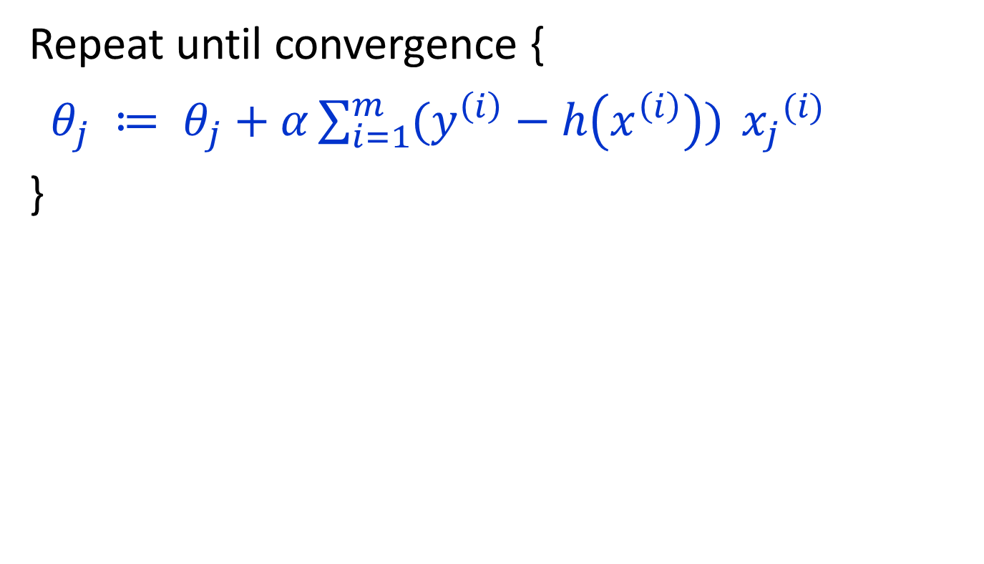
m training examples
Repeat until convergence {
$θ_{j} ≔ θ_{j}+α\sum_{i=1}^{m}{(y^{\left(i\right)}−h\left(x^{\left(i\right)}\right)) }{x_{j}}^{(i)}$
}

Slide 67

Linear regression with one variable using gradient descent

Slide 68

Linear regression with one variable using gradient descent

Slide 69

Linear regression with one variable using gradient descent

Slide 70

Analysis

Slide 71

Analysis

Slide 72

Analysis

Slide 73
Introduction to Machine Learning (BCSE-0701 ) Day-18
Topic
Correlation Coefficient

Slide 74
Correlation
Correlation coefficients are used in statistics to measure how strong a relationship is between two variables.
It lies in the range [-1,+1]

Slide 75

Correlation
Formula
The extreme values of r will be as follows:
+1 indicates a strong positive relationship.
-1 indicates a strong negative relationship.
zero indicates no relationship at all.

Slide 76
Correlation
Meaning
(i) +1 means that for every positive increase in one variable, there is a positive increase of a fixed proportion in the other. For example, shoe sizes go up in (almost) perfect correlation with foot length.
(ii) -1 means that for every positive increase in one variable, there is a negative decrease of a fixed proportion in the other. For example, the amount of gas in a tank decreases in (almost) perfect correlation with speed.
(iii) Zero means that for every increase, there isn’t a positive or negative increase. The two just aren’t related.

Slide 77
Practice
Answer=1.66
Q1. Consider a linear-regression model with N=3 and D=1 with input-output pairs as follows:
y1=22, x1=1, y2=3, x2=1, y3=3, x3=2
What is the gradient of mean-square error (MSE) with respect to β1 (when β0=0 and β1=1)? Give your answer correct to two decimal digits.

Slide 78

Practice
Q2.

Slide 79

Practice
Q3.

Slide 80
Practice
Q4. Consider the problem of predicting how well a student does in her second year of college/university, given how well she did in her first year.
Specifically, let x be equal to the number of "A" grades (including A-. A and A+ grades) that a student receives in their first year of college. We would like to predict the value of y, which we define as the number of "A" grades they get in their second year.
Here each row is one training example. Recall that in linear regression, our hypothesis is h_{θ}(x)=θ₀+θ₁x, and we use N to denote the number of training examples.

Slide 81
Introduction to Machine Learning (BCSE-0701 ) Day-21
Topic
Logistic Regression

Slide 82



Logistic Regression
Linear Regression:
$$h\left(x\right)=\sum_{i=0}^{n}{θ_{i}x_{i}}$$
Logistic Regression for classification:
$$h_{θ}\left(x\right)=\frac{1}{1+e^{−\sum_{i=0}^{n}{θ_{i}x_{i}}}}=g(\sum_{i=0}^{n}{θ_{i}x_{i}})$$
$g\left(z\right)=\frac{1}{1+e^{−z}}$
is called the logistic function or the sigmoid function.
Logistic:
$g\left(z\right)=\frac{1}{1+e^{−z}}$

Slide 83
Introduction to Machine Learning (BCSE-0701 ) Day-22
Topic
Logistic Regression

Slide 84
Logistic Regression
Linear Regression:
$$h\left(x\right)=\sum_{i=0}^{n}{θ_{i}x_{i}}$$
Logistic Regression for classification:
$$h_{θ}\left(x\right)=\frac{1}{1+e^{−\sum_{i=0}^{n}{θ_{i}x_{i}}}}=g(\sum_{i=0}^{n}{θ_{i}x_{i}})$$
$g\left(z\right)=\frac{1}{1+e^{−z}}$
is called the logistic function or the sigmoid function.
Logistic:
$g\left(z\right)=\frac{1}{1+e^{−z}}$

Slide 85

Sigmoid function properties
Bounded between 0 and 1
$g(z)→1$ as $z→∞$
$g(z)→0$ as $z→−∞$
$$g^{′}\left(z\right)=\frac{d}{dz}\frac{1}{1+e^{−z}}$$
$$=\frac{1}{{(1+e^{−z})}^{2}}.e^{−z}$$
$$=\frac{1}{1+e^{−z}}.(1−\frac{1}{1+e^{−z}})$$
$=g(z)(1−g\left(z\right)$)

Slide 86

Logistic regression (sigmoid classifier)
The condition distribution: a Bernoulli
We can used the gradient method as in Linear Regression

Slide 87

Logistic Regression
In logistic regression, we learn the conditional distribution P(y|x)
Let p_{y}(x; $θ$) be our estimate of P(y|x), where $θ$ is a vector of adjustable parameters.
Assume there are two classes, y = 0 and y = 1 and
$$P\left(y=1 | x\right)=h_{θ}\left(x\right)$$
$$P\left(y=0 | x\right)=1−h_{θ}(x)$$
Can be written more compactly
$$P\left(y | x\right)={h(x)}^{y}{(1−h\left(x\right))}^{1−y}$$
We can used the gradient method

Slide 88

Maximize likelihood
$$L\left(θ\right)=p(\vec{y}|X;θ)$$
$$=\prod_{i=1}^{m}{p(y_{i}|x_{i};θ)}$$
$$=\prod_{i=1}^{m}{{h(x_{i}^{})}^{y_{i}}{(1−h\left(x_{i}\right))}^{1−y_{i}}}$$
$$l\left(θ\right)=\log\left(L\left(θ\right)\right)$$
$$=\sum_{i=1}^{m}{y^{i}\log{h(x^{i})}+(1−y_{i})(\log{(1−h(x_{i})})}$$

Slide 89

$$lθ=\sum_{i=1}^{m}{y^{i}\log{h(x^{i})}+(1−y_{i})(\log{(1−h(x_{i})})}$$
How do we maximize the likelihood? Gradient ascent
Updates: $θ=θ+α∇_{θ}l(θ)$
Assume one training example (x,y), and take derivatives to derive the stochastic gradient ascent rule.
$$\frac{∂}{∂β_{j}}l\left(β\right)$$
$$=(\left(y\frac{1}{g(β^{T}(x)} \right)−\left(1−y\right)\frac{1}{1−g\left(β^{T}x\right)})\frac{∂}{∂β_{j}}g(β^{T}x)$$
$$=(\left(y\frac{1}{g(β^{T}(x)} \right)−\left(1−y\right)\frac{1}{1−g\left(β^{T}x\right)}) g(β^{T}x)(1−g(β^{T}x)\frac{∂}{∂β_{j}}β^{T}x$$
$$=(y\left(1−g\left(β^{T}x\right)\right)−\left(1−y\right)g\left(β^{T}x\right))x_{j}$$
$$=(y−h_{β}\left(x\right))x_{j}$$

Slide 90
Introduction to Machine Learning (BCSE-0701 ) Day-24
Topic
Logistic Regression

Slide 91

Assumptions
Binary logistic regression requires the dependent variable to be binary.
Only the meaningful variables should be included.
The independent variables should be independent of each other. That is, the model should have little or no multicollinearity.
The independent variables are linearly related.
Logistic regression requires quite large sample sizes.

Slide 92


Consider a problem of predicting gender of a person based on his age and income.
$$Z=\sum_{i=0}^{2}{θ_{i}x_{i}}$$
Y $=\frac{1}{1+e^{−Z}}$

Slide 93
Introduction to Machine Learning (BCSE-0701 ) Day-25
Topic
Features Reduction Machine Learning

Slide 94



Dimensionality Reduction
Features in Machine Learning
Given a set of features $F=\left\{x_{1}, …,x_{N}\right\},$the dimensionality reduction problem is to map $F$ to some feature set $F′′$ with less number of features than number of features in $F,$to reduce the complexity of model to be trained.
The following two components of dimensionality reduction.
Feature Selection : To remove irrelevent and redundant features.
Feature Extraction : Transformation of data from high dimensional space to lower dimension space.
Assumption: Assuming that N features are linear combination of $M<N$ vectors.
$$Y_{i}=w_{i1}x_{i1}+…+w_{id}x_{iN}$$
$$Y=w^{T}x$$
Objective: To find a projection matrix w from N-dimensional to M-dimensional vectors that keeps error low.
Fig.1 Process of feature extraction in dimensionality reduction

Slide 95

Curse of Dimensionality
number of training examples is fixed
=> the classifier’s performance usually will degrade for a large number of features!

Slide 96
Feature Reduction in ML
Irrelevant and
redundant features
can confuse learners.
Limited training data.
Limited computational resources.
Curse of dimensionality.

Slide 97

Feature Selection
Problem of selecting some subset of features, while ignoring the rest
Feature Extraction
Project the original x_{i} , i =1,...,d dimensions to new $k<d$dimensions, z_{j} , j =1,...,k
Criteria for selection/extraction:
either improve or maintain the classification accuracy, simplify classifier complexity.

Slide 98


Feature Selection - Definition
Given a set of features $F=\{x_{1}, …,x_{n}\}$
the Feature Selection problem is
to find a subset $F′⊆F$ that maximizes the learners
ability to classify patterns.
Formally $F′$ should maximize some scoring function

Slide 99

Subset selection
d initial features
There are $2^{d}$ possible subsets
Criteria to decide which subset is the best:
classifier based on these m features has the lowest probability of error of all such classifiers
Can’t go over all $2^{d}$ possibilities
Need some heuristics

Slide 100

Feature Selection Steps
Feature selection is an optimization problem.
Step 1: Search the space of possible feature subsets.
Step 2: Pick the subset that is optimal or near-optimal with respect to some objective function.

Slide 101
Introduction to Machine Learning (BCSE-0701 ) Day-26
Topic
Features Reduction Machine Learning (contd…)

Slide 102
Feature Selection
It enables the machine learning algorithm to train faster.
It reduces the complexity of a model and makes it easier to interpret.
It improves the accuracy of a model if the right subset is chosen.
It reduces overfitting.
Filter Methods
Wrapper Methods
Filter Methods: The selection of features is independent of any machine learning algorithms. Instead, features are selected on the basis of their scores in various statistical tests for their correlation with the outcome variable.
Wrapper Methods: In wrapper methods, we try to use a subset of features and train a model using them. Based on the inferences that we draw from the previous model, we decide to add or remove features from your subset. The problem is essentially reduced to a search problem.

Slide 103


Evaluation Strategies
Filter Methods
Wrapper Methods

Slide 104
Subset selection
Select uncorrelated features
Forward search
Start from empty set of features
Try each of remaining features
Estimate classification/regression error for adding specific feature
Select feature that gives maximum improvement in validation error
Stop when no significant improvement
Backward search
Start with original set of size d
Drop features with smallest impact on error

Slide 105
Feature selection
Filter methods
Basic
Correlation based
Statistical ranking based

Slide 106


Pearson correlation coefficient
Measures the correlation between two variables
Formula for Pearson correlation =
The correlation r is between $+1$ and $−1$.
$+1$ means perfect positive correlation
$−1$ in the other direction

Slide 107
Signal to noise ratio
Difference in means divided by difference in standard deviation between the two classes
S2N(X,Y) = (μ_{X} - μ_{Y})/(σ_{X} – σ_{Y})
Large values indicate a strong correlation

Slide 108
Multivariate feature selection
Multivariate (considers all features simultaneously)
Consider the vector w for any linear classifier.
Classification of a point x is given by w^{T}x+w₀.
Small entries of w will have little effect on the dot product and therefore those features are less relevant.
For example if w = (10, .01, -9) then features 0 and 2 are contributing more to the dot product than feature 1.
A ranking of features given by this w is 0, 2, 1.

Slide 109
Multivariate feature selection
The w can be obtained by any of linear classifiers
A variant of this approach is called recursive feature elimination:
Compute w on all features
Remove feature with smallest w_{i}
Recompute w on reduced data
If stopping criterion not met then go to step 2

Slide 110


Principle Component Analysis (PCA)
Feature Extraction
Objectives of PCA
(i) Minimize Correlation
Choose vectors that are orthogonal.
(i) Maximize Total Variance
Choose vectors such that a total variance of data will be maximum.
Choose $M<N$ orthogonal directions which maximize total variance.
Fig.6 Geometric Interpretation of PCA

Slide 111
Example: Consider the following data matrix, representing the marks of 5 students in 3 subjects such as Mathematics (M), English (E), and Art (A).
Demo Lecture (contd…)
Student | M | E | A
1 | 90 | 60 | 90
2 | 90 | 90 | 30
3 | 60 | 60 | 60
4 | 60 | 60 | 90
5 | 30 | 30 | 30
Steps to compute PCs.
Step-1: Compute mean of each column, and center each column on its mean.
S.N. | M | E | A
1 | 90 | 60 | 90
2 | 90 | 90 | 30
3 | 60 | 60 | 60
4 | 60 | 60 | 90
5 | 30 | 30 | 30
Mean | 66 | 60 | 60
Data matrix (X) centered at mean.
M-66 | E-60 | A-60
24 | 0 | 30
24 | 30 | -30
-6 | 0 | 0
-6 | 0 | 30
-36 | -30 | -30

Slide 112




Demo Lecture (contd…)
Step-2: Compute co-variance matrix of centered data matrix (X).
Step-5: Compute new feature matrix (Y) as:
Z=Covariance matrix of X = $\left[\begin{matrix}504 & 360 & 180 \\ 360 & 360 & 0 \\ 180 & 0 & 720\end{matrix}\right]$
$$Y=xw^{}$$
Step-3: Compute Eigen vectors and Eigen Values of matrix Z.
The obtained eigen values are λ = 44.81, 629.11, and 910.06.
The respective eigen vectors will as:
$$\left[\begin{matrix}−3.75 & −0.504 & 1.05 \\ 4.28 & −0.67 & 0.69 \\ 1 & 1 & 1\end{matrix}\right]$$
NOTE:
The PCA does not eliminate column of given data matrix. Rather, it transformed the data matrix (X) into new data matrix (Y), which has less number of features than in X.
Step-4: Select two eigen vectors having highest eigen values as matrix W.
$$W=\left[\begin{matrix}1.05 & −0.50 \\ 0.69 & −0.67 \\ 1 & 1\end{matrix}\right]$$

Slide 113
Evaluating feature subset
Supervised (wrapper method)
Train using selected subset
Estimate error on validation dataset
Unsupervised (filter method)
Look at input only
Select the subset that has the most information

